Slide 1

SMART INDIA HACKATHON 2026
Problem Statement ID – SIH2026171
Problem Statement Title - On-Device Visual Perception for Light-weight Browser Agent
Theme - Smart Automation
PS Category - Software
Team ID -
Team Name – The Honoured Ones
.

Slide 2





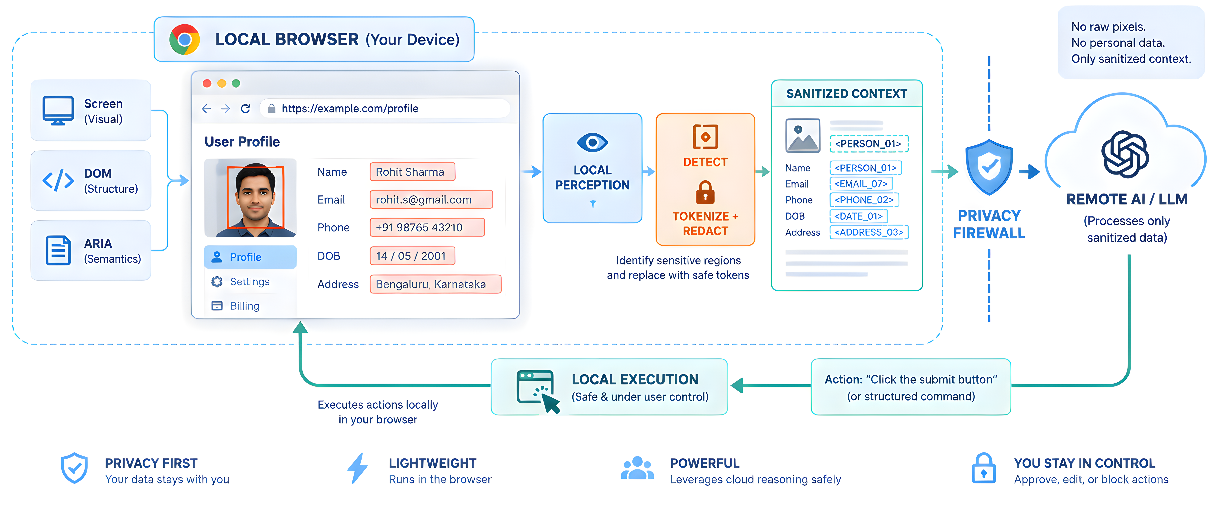
ANTARDRISHTI
THE PROBLEM : AI AGENTS NEED TO SEE—BUT SHOULD NOT SEE EVERYTHING
AI browser agents can visually understand and operate our websites. But raw screen content can contain sensitive information, while DOM-only approaches cannot capture everything users actually see.
PRIVACY EXPOSURE
VISUAL BLIND SPOTS
THE LOCAL REASONING TRADE-OFF
P01
Screens can contain sensitive information such as credentials, financial data, private documents.
P02
DOM-only agents can miss canvas, images, PDFs, visual overlays, and rendered content.
P03
Full visual reasoning on constrained devices can be computationally expensive, while sending raw visual content to remote AI creates privacy risk.
A browser-native privacy firewall that combines:
screen + DOM + ARIA perception,
Detects sensitive content locally, redacts/tokenizes it while preserving task-relevant context, and exposes only sanitized context to remote AI reasoning, while having guardrails and egress gate
for Data leak protection.
DESIGNED AROUND GIVEN CRITERIA
2

Slide 3
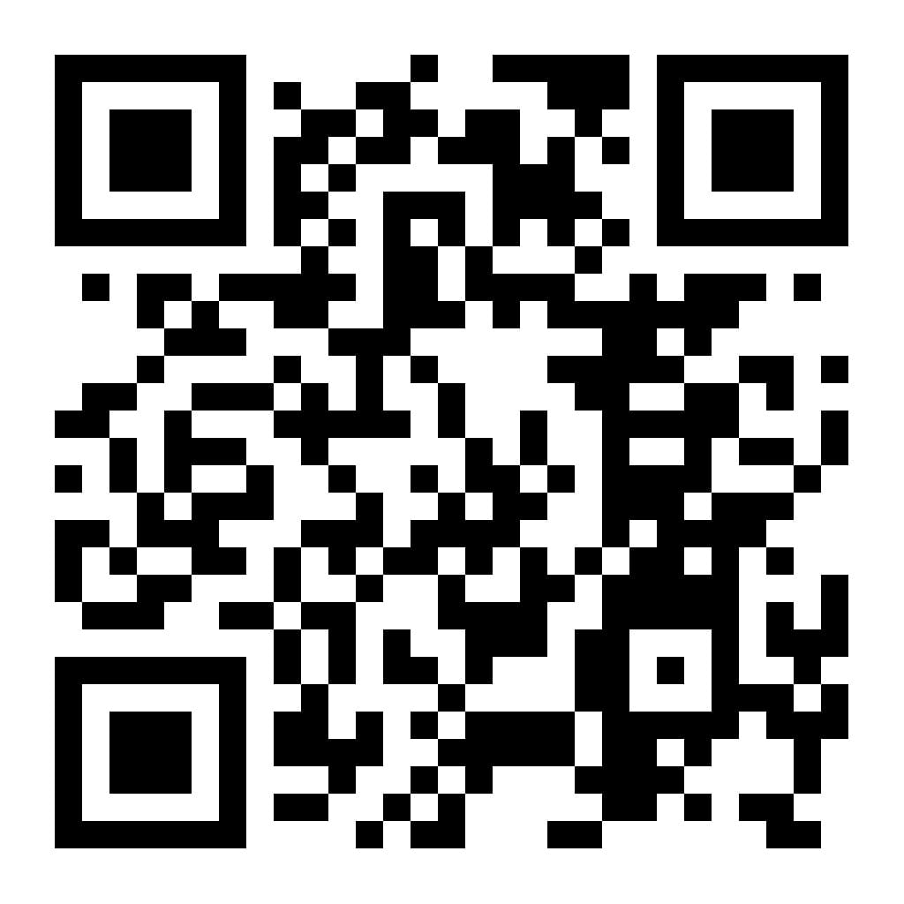
.
Technical Approach
SOFTWARE :
Flow Chart(For one successful iteration) :
SOURCE CODE
Chrome & Firefox Web Extension(MV3)
JavaScript / TypeScript
ONNX Runtime Web
WebGPU + WASM Fallback
DOM + Reconstructed ARIA semantics
Local Privacy + Token Vault + Policy Engine
Remote Planner / LLM-VLM endpoint
GitHub · BLx-Ankush/AGENT
Code • Architecture • Evaluation
LOCAL PERCEPTION + PRIVACY
ON-DEVICE PRIVACY BOUNDARY
2
ONLY SANITIZED DATA
REMOTE REASONING
1
EVENT + RISK
LOW • DOM / A11Y
DOM
A11Y
SCREEN
ROUTER
EGRESS
GATE
CLOUD REASONER
MED • OCR + CV
NO RAW PII
page / UI change → re-evaluate
HIGH • VLM
ALLOW ONLY
SANITIZED
LLM / VLM
planning + reasoning
3
4
5
6
UNIFIED SCENE GRAPH
PRIVACY ENGINE
TOKENIZE
+ REDACT
SANITIZED
STATE
FAIL CLOSED
LOCAL PERCEPTION:
PII • faces • secrets
Screen capture
DOM + ARIA harvesting
OCR / text detection
Face detection
Visual UI / region detection
DOM ↔ Vision reconciliation
3
RAW PRIVATE PIXELS + VALUES NEVER CROSS THE BOUNDARY
ACTION PLAN
7. REMOTE PLAN RETURNS → LOCAL POLICY CHECK → LOCAL EXECUTION
ACTION PLAN
tokens + capabilities
tokens + capabilities
page / UI change → re-evaluate locally
RETURN TO → LOCAL
Model-Agnostic Perception Layer:
REAL BROWSER
EXECUTION ADAPTER
LOCAL TOKEN VAULT
Pluggable(Adapter-Based)
OCR • CV • Vision Models
DOM / A11Y
WebMCP*
ACTION SAFETY GATE
default
optional
resolve
<EMAIL_07> → value
.
3
DOM/A11y = universal path • WebMCP = optional
.

Slide 4
.
Feasibility & Viability
.
Technical Feasibility :
RISK | SEVERITY | MITIGATION
Limited browser compute | 🔴 HIGH | Event-driven + tiered perception
Missed PII / faces | 🔴 HIGH | Multi-stage detection + conservative policy
Perception latency | 🔴 MEDIUM | Tiered inference + selective visual processing
Privacy leakage | 🔴 HIGH | Independent egress verification + fail closed
Browser-native execution:
Chrome/Firefox + WebGPU / WASM fallback.
Tiered perception: DOM / A11y first → Vision / OCR only where required
Local privacy enforcement:
PII/faces/secrets → tokenized/redacted
Fail-closed security:
Verified Egress + action safety gate + local execution policy
Scalability: [Adapter-Based Perception]
Model-Independent core : Swap perception models without changing the privacy engine
Common adapter interface : OCR / face / vision models plug into the same pipeline
Benchmark-driven selection: Compare accuracy, latency, size and browser backend before deployment
Resource Viability:
Open-weight models : Replaceable perception components
Browser-side perception : keeps visual processing local
Server reasoning : remote component handles computationally heavier planning
.
4

Slide 5
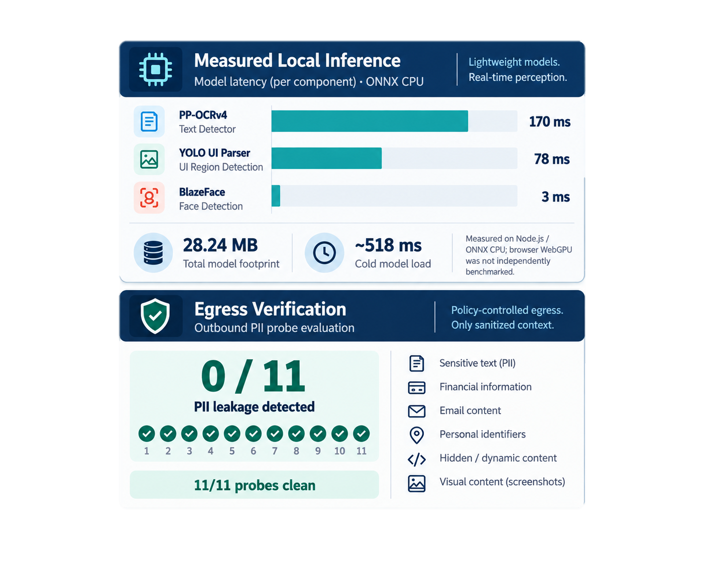
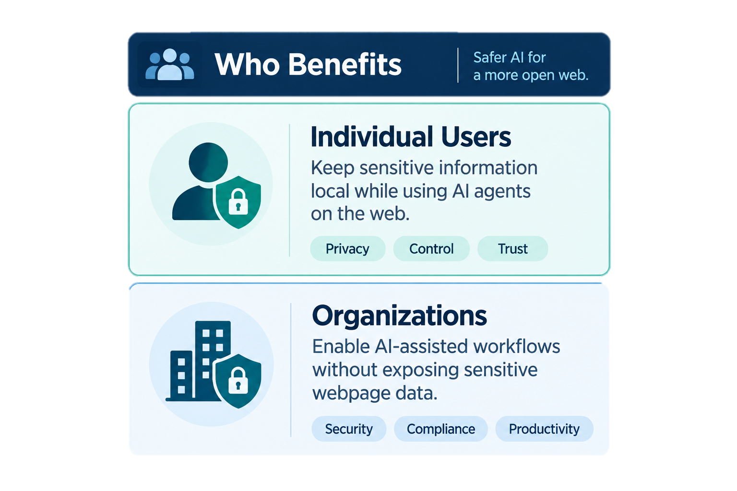
.
Impact & Benefits
.
Evaluation Metric | Existing | ANTARDRISHTI (Enhancement)
Visual context accuracy | Cloud/desktop GUI agents | Local multimodal scene understanding
PII precision & recall | WebRedact baseline | Multi-stage local detection
Redaction precision | Existing visual redactors | Policy-controlled redaction
Client resource usage | Host/cloud processing | Browser WebGPU/WASM+model adapters
Measured = ANTARDRISHTI evaluation
Published = external research
.
5

Slide 6
.
Research & Analysis
.
PROBLEM & GAP:
Scattered Solutions:
Raw screenshots expose PII to remote GUI agents.
DOM-only perception misses canvas, images, video, PDFs, iframes & visual overlays.
Privacy protection must preserve task-relevant visual context.
GUIGuard: privacy recognition → protection → task execution
PrivWeb: local LLM-based interface anonymization
CAPED: task-aware selective screenshot exposure
WebPII/WebRedact: visual PII detection & redaction
Research:
PrivWeb — CHI 2026 ; CAPED — arXiv ; WebPII — arXiv
Research:
GUIGuard — Privacy-Preserving GUI Agents
Our Research:
BENCHMARK: (Published results)
RESEARCH FINDING
DOM-only misses visual webpage content | DOM + A11Y + Vision Multimodal scene understanding
PII recognition has know failure modes | Deterministic-first tiered perception + verification
Raw Screenshot exposes sensitive information | Local Sanitization + verified fail-closed egress
WebRedact: 0.753 mAP@50 at ~20 ms CPU.¹
CAPED: seeded leakage reduced 0.766 → 0.268.²
GUIGuard: privacy recognition remains a major bottleneck.³
Sema: 130–210× lower screenshot uplink, ≤0.7 pp accuracy loss.⁴
Research:
WebPII / WebRedact ·CAPED ·GUIGuard ·Sema
Interchangeable model adapters • benchmark-driven selection
.
6

